Slide 1
Machine Learning with Survival Analysis

Slide 2
Overview
Basic Concepts of Survival Analysis
Statistical and Machine Learning Methods
Data import, cleansing, transformation
Deploying and consuming in Microsoft Azure Machine Learning Studio

Slide 3
Basic Concepts of Survival Analysis

Slide 4
What is Survival Analysis?
Survival Analysis is referred to statistical methods for analyzing survival data
Survival data could be derived from laboratory studies of animals or from clinical and epidemiologic studies
Survival data could relate to outcomes for studying acute or chronic diseases

Slide 5
What is Survival Time?
Survival time refers to a variable which measures the time from a particular starting time (e.g., time initiated the treatment) to a particular endpoint of interest (e.g., attaining certain functional abilities)
It is important to note that for some subjects in the study a complete survival time may not be available due to censoring

Slide 6
Censored Data
Some Objects may still be alive or in remission at the end of the study period
The exact survival times of these subjects are unknown
These are called censored observation or censored times and can also occur when individuals are lost to follow-up after a period of study

Slide 7
Random Right Censoring
Suppose 4 patients with acute leukemia enter a clinical study for three years
Remission times of the four patients are recorded as 10, 15+, 35 and 40 months
15+ indicate that for one patient the remission time is greater than 15 months but the actual value is unknown

Slide 8
Important Areas of Application
Clinical Trials (e.g., Recovery Time after heart surgery)
Longitudinal or Cohort Studies (e.g., Time to observing the event of interest)
Life Insurance (e.g., Time to file a claim)
Quality Control & Reliability in Manufacturing (e.g., The amount of force needed to damage a part such that it is not useable)

Slide 9
Survival Function or Curve
Let T denote the survival time
S(t) = P(surviving longer than time t )
= P(T > t)
The function S(t) is also known as the cumulative survival function. 0 S( t )  1
Ŝ(t)=number of objects surviving longer than t
total number of objects in the study

Slide 10
In 1958, Product-Limit (P-L) method was introduced by Kaplan and Meier (K-M)
As you move from left to right in estimation of the survival curve first assign equal weights to each observation. Do not jump at the censored observations
Redistribute equally the pre-assigned weight to the censored observations to all observations to the right of each censored observation
Median survival is a point of time when S(t) is 0.5
Mean is equal to the area under the survival curve

Slide 11
A few critical features of P-L or K-M Estimator
The PL method assumes that censoring is independent of the survival times
K-M estimates are limited to the time interval in which the observations fall
If the largest observation is uncensored, the PL estimate at that time equals zero

Slide 12
Comparison Of Two Survival Curves
Let S₁(t) and S₂(t) be the survival functions of the two groups.
The null hypothesis is
H₀: S₁(t) =S₂(t), for all t > 0
The alternative hypothesis is:
H₁: S₁(t) ≠ S₂(t), for some t > 0

Slide 13
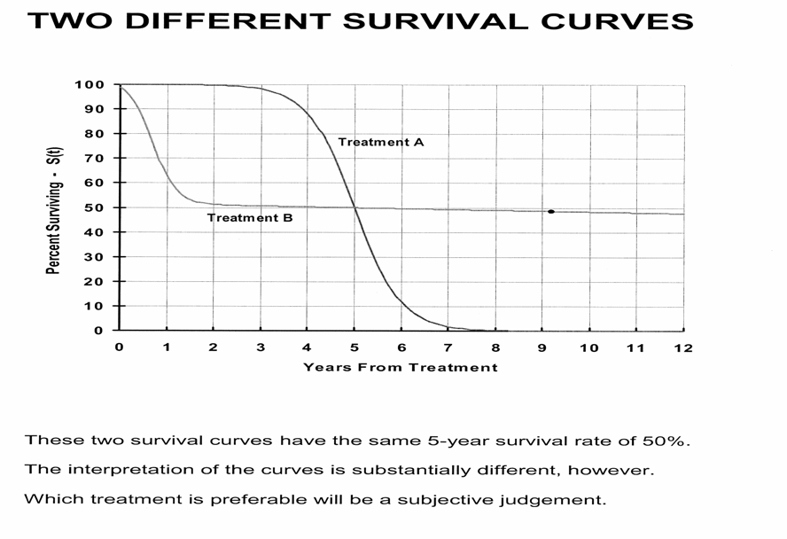

Slide 14
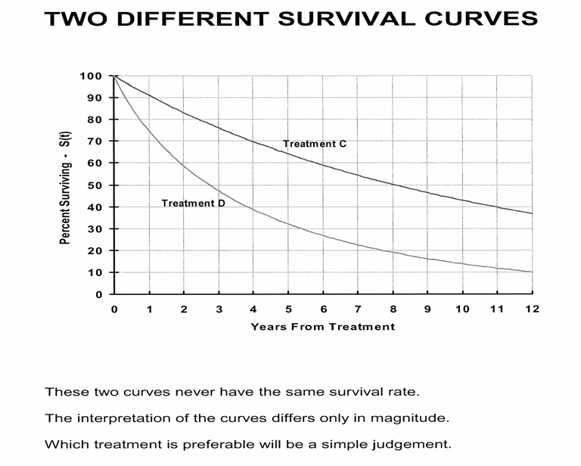

Slide 15
The Logrank Test
SPSS, SAS, S-Plus and many other statistical software packages have the capability of analyzing survival data
Logrank Test can be used to compare two survival curves
A p-value of less than 0.05 based on the Logrank test indicate a difference between the two survival curves

Slide 16
EXAMPLE
Survival time of 30 patients with Acute Myeloid Leukemia (AML)
Two possible prognostic factors
Age = 1 if Age of the patient ≥ 50
Age = 0 if Age of the patient < 50
Cellularity = 1 if cellularity of marrow clot section is 100%
Cellularity = 0 otherwise

Slide 17
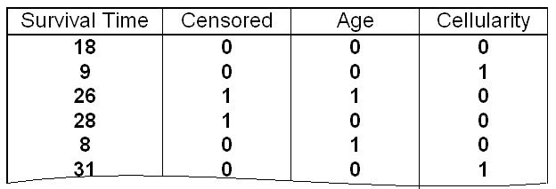
Format of the DATA
Survival Times and Data of Two Possible Prognostic Factors of 30 AML Patients
* Censored = 1 if Lost to follow-up
Censored = 0 if Data is Complete

Slide 18
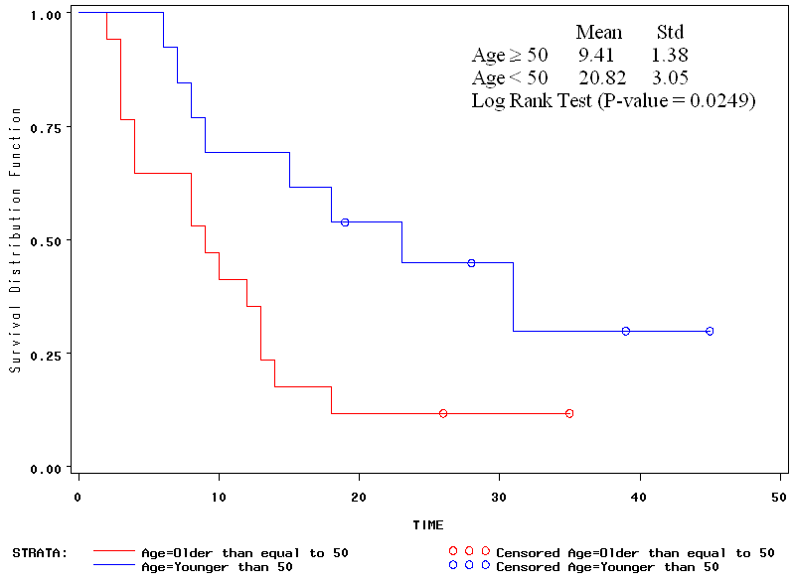
Comparing the survival curves by Age Groups using Logrank Test

Slide 19
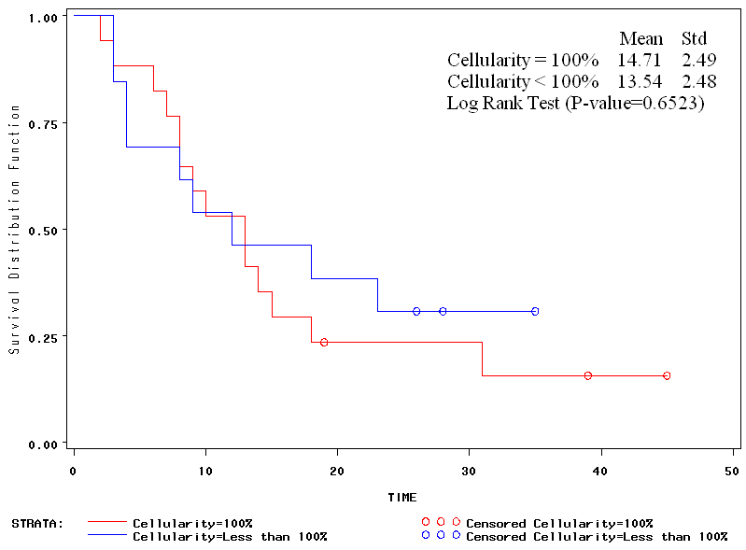
Comparing the survival curves by Cellularity using Logrank Test

Slide 20
Hazard Function
The hazard function h(t) of survival time T gives the conditional failure rate
The hazard function is also known as the instantaneous failure rate, force of mortality, and age-specific failure rate
The hazard function gives the risk of failure per unit time during the aging process

Slide 21
Multivariate Analysis: (CPHM) Cox's Proportional Hazards Model
CPHM is a technique for investigating the relationship between survival time and independent variables
A PHM possesses the property that different individuals have hazard functions that are proportional to one another

Slide 22
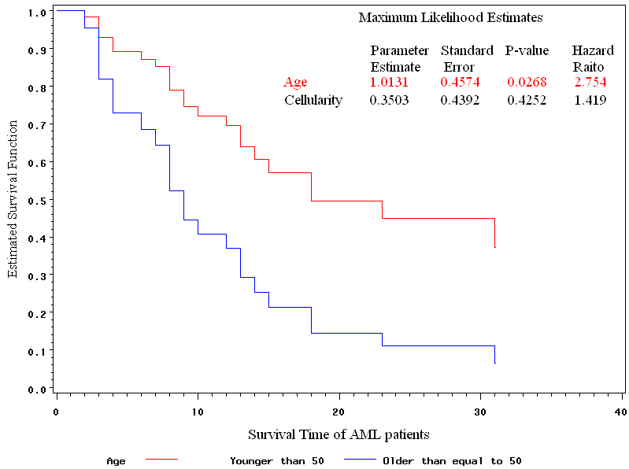
Comparing the survival curves by Age Groups after Adjusting Cellularity using CPHM

Slide 23
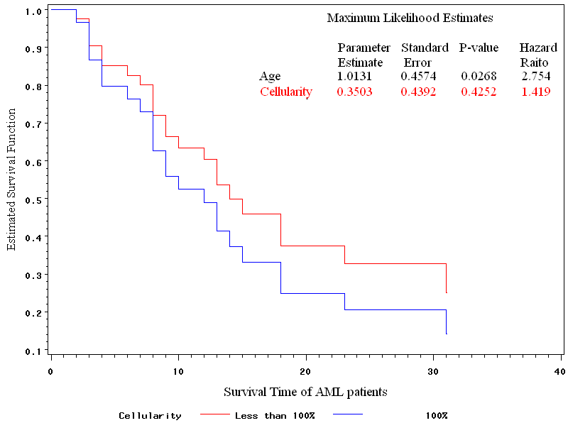
Comparing the survival curves by Cellularity Groups after Adjusting Age using CPHM

Slide 24
Statistical and Machine Learning Methods

Slide 25
Preparing Data
Importing data from a variety of data sources
Feature Engineering
Cleaning, normalizing, and transforming raw data
Deploying Models
Deploying trained models as web service
Exploring, visualizing and Joining data sources
Grouping, filtering, and rebalancing data
Configuring parameters and run-time options
Training Models
Training and Evaluating machine learning models

Slide 26
The Azure Machine Learning Studio in Context
Data Science Process
Use Cases
Microsoft Machine Learning and Artificial Intelligence Portfolio

Slide 27
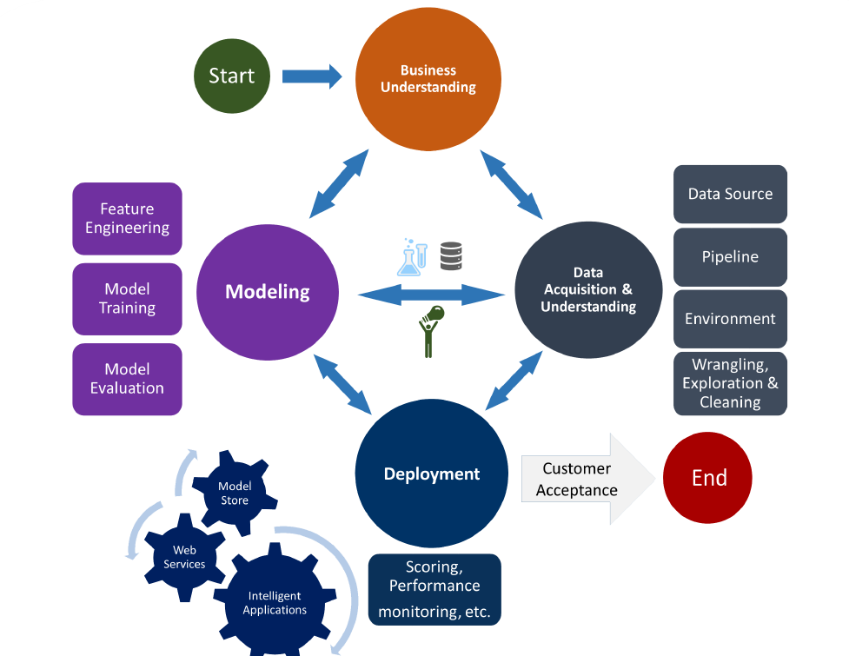
Data Science Lifecycle

Slide 28

When to Use the Azure Machine Learning Studio

Slide 29
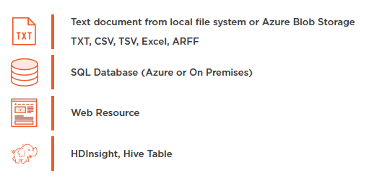
Preparing Data and Data Sources

Slide 30
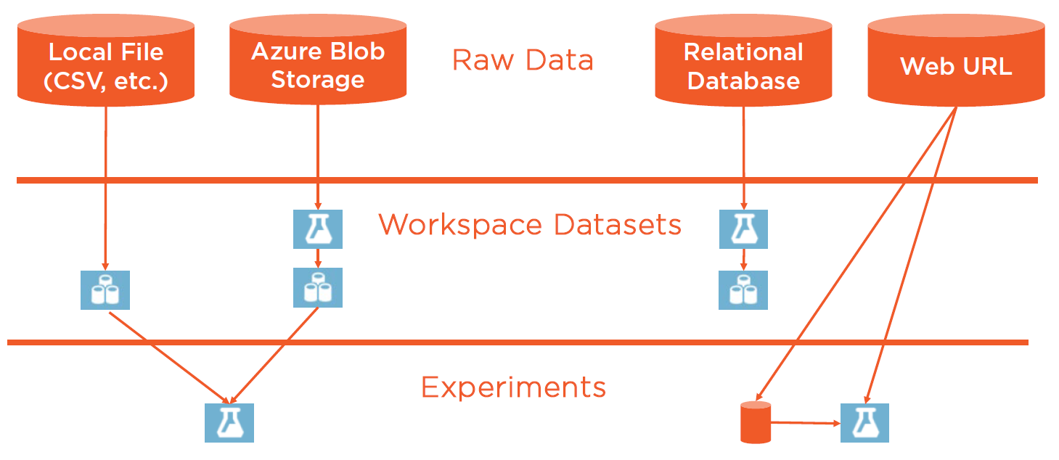
Preparing Data and Data Sources

Slide 31
Add Columns or Add Rows
Join Data
Apply SQL Transformation
Execute R or Python Script
Joining Data Sets

Slide 32
Data import, cleansing, transformation

